Slide 1
CS 347 Final Project Review
Chanhee Park | Syngjin Shin | Justin Winata

Slide 2
Models

Slide 3
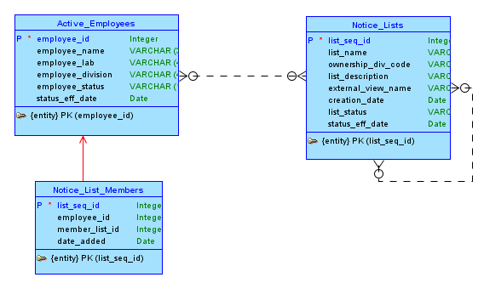
Conceptual Model

Slide 4
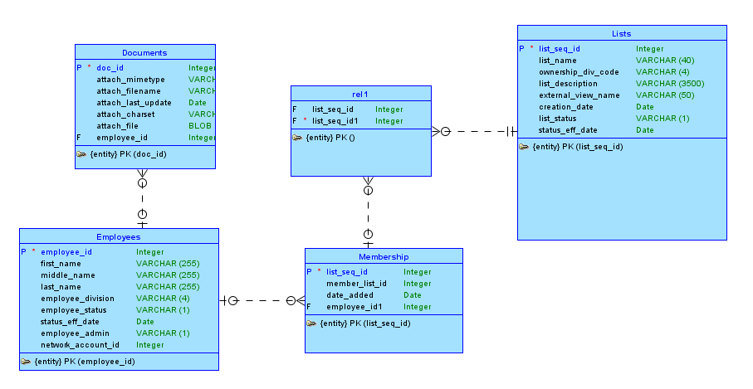
Logical Model

Slide 5
Features & Implementations

Slide 6
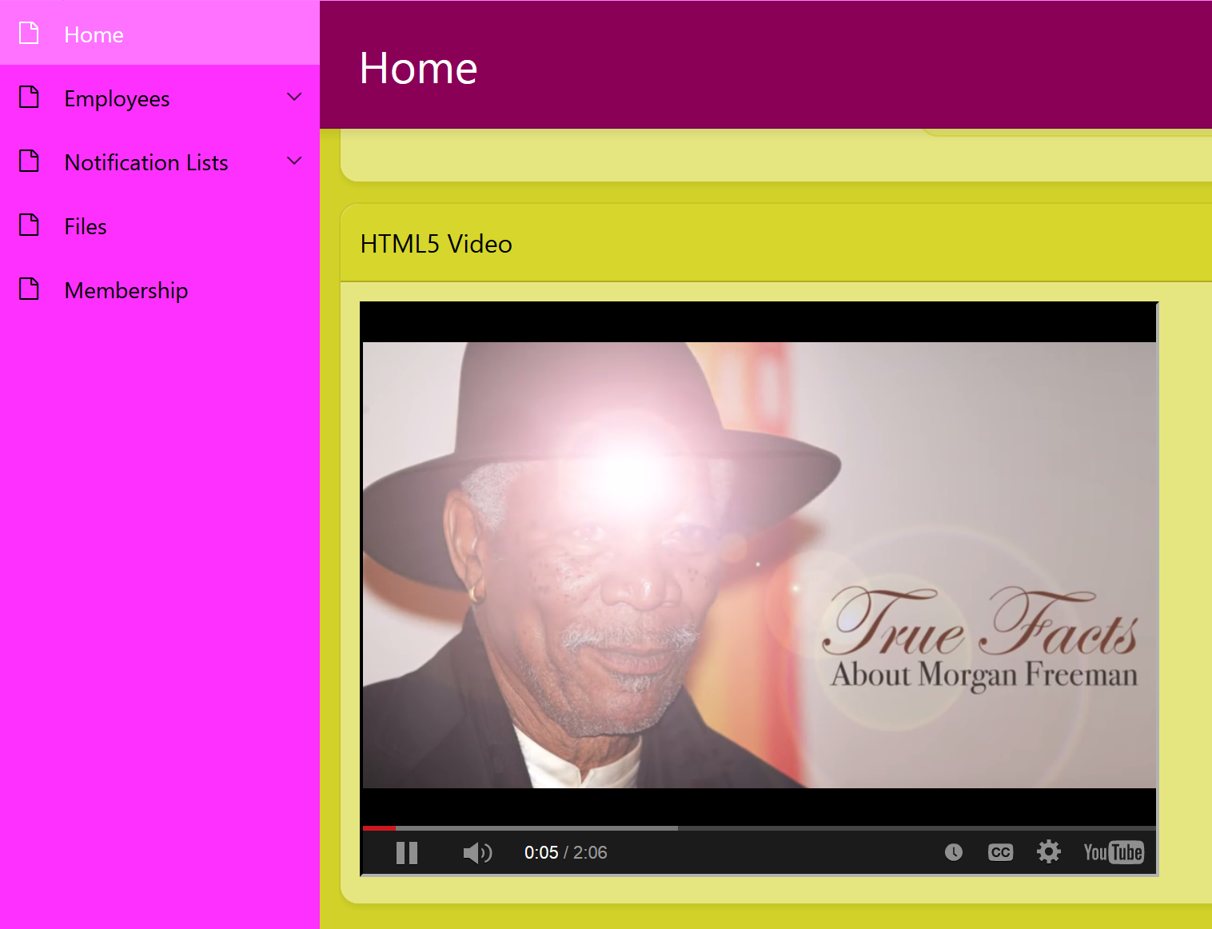
HTML Video

Slide 7
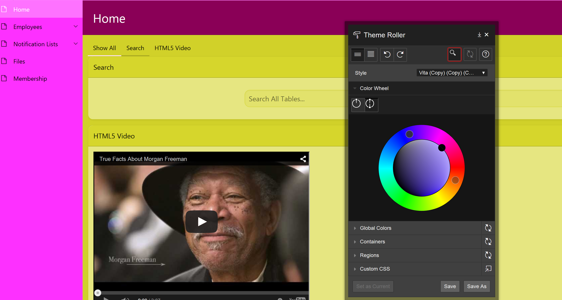
Theme Roller

Slide 8
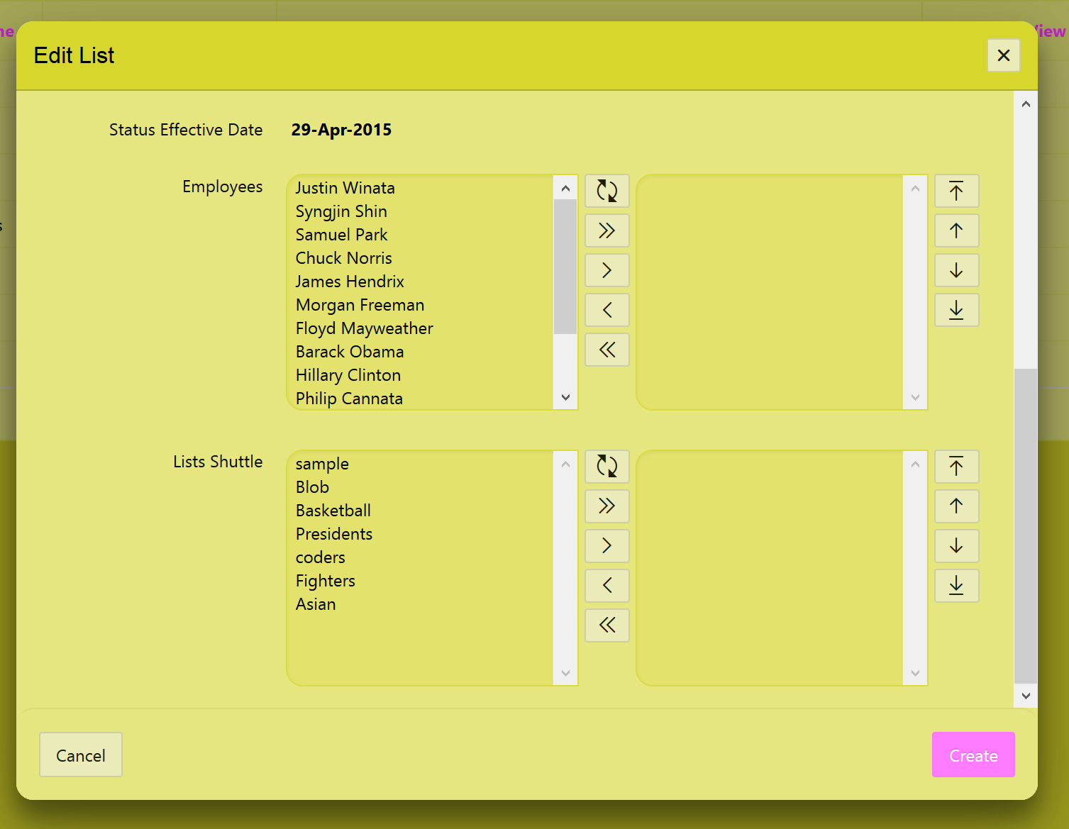
Shuttles

Slide 9
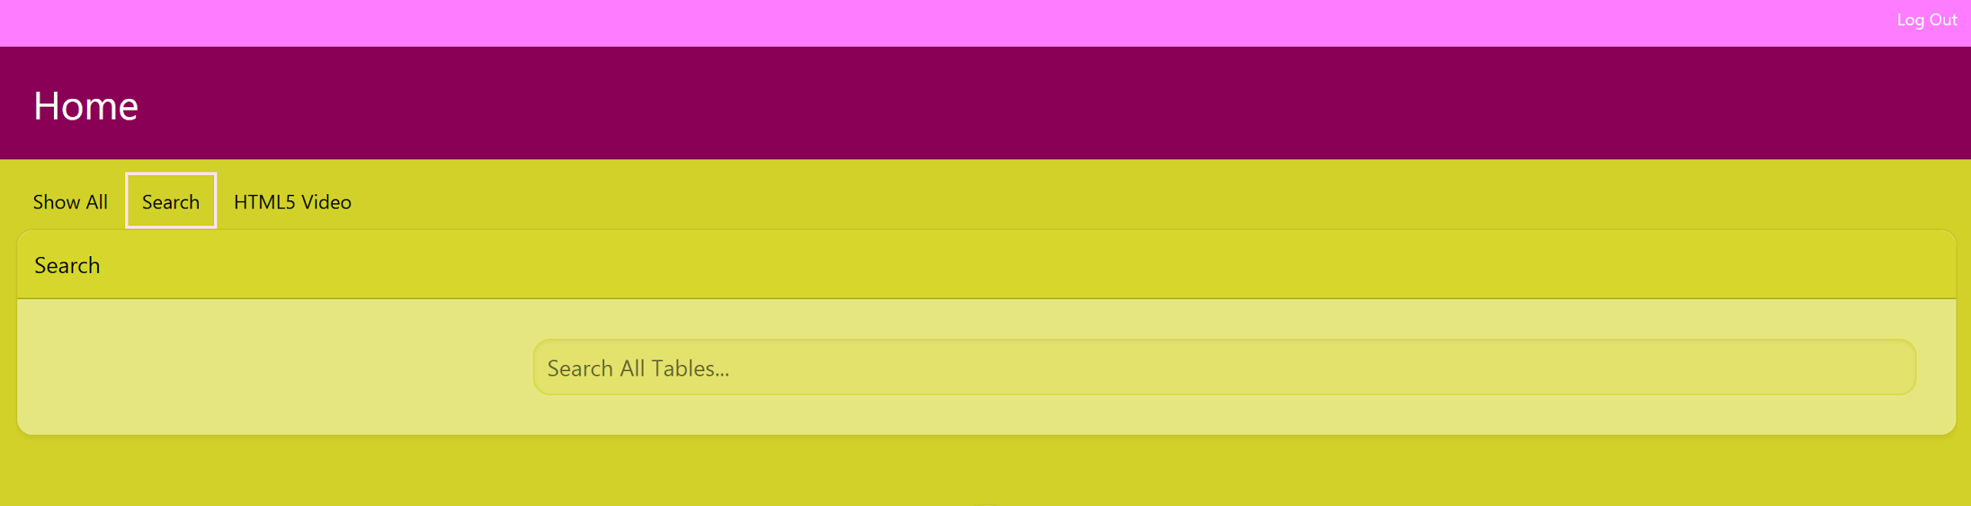
Region Display Selector

Slide 10
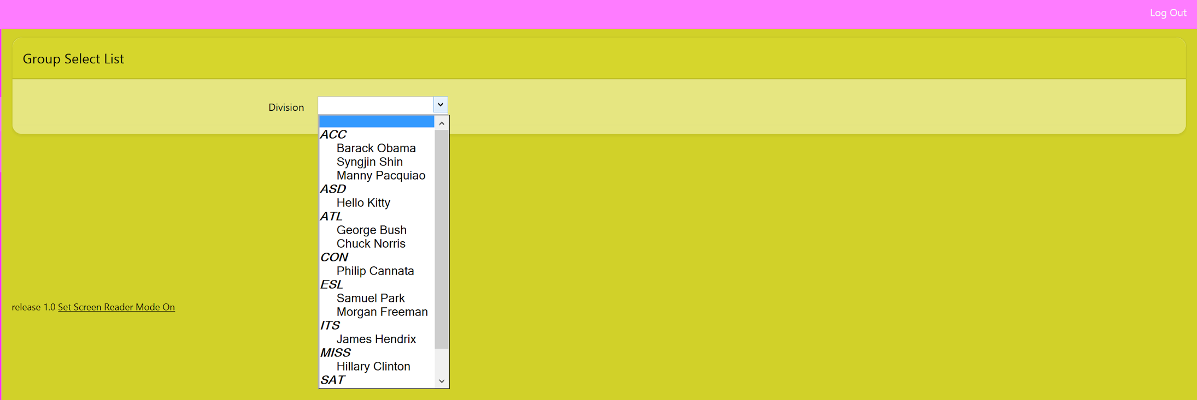
Group Select List

Slide 11
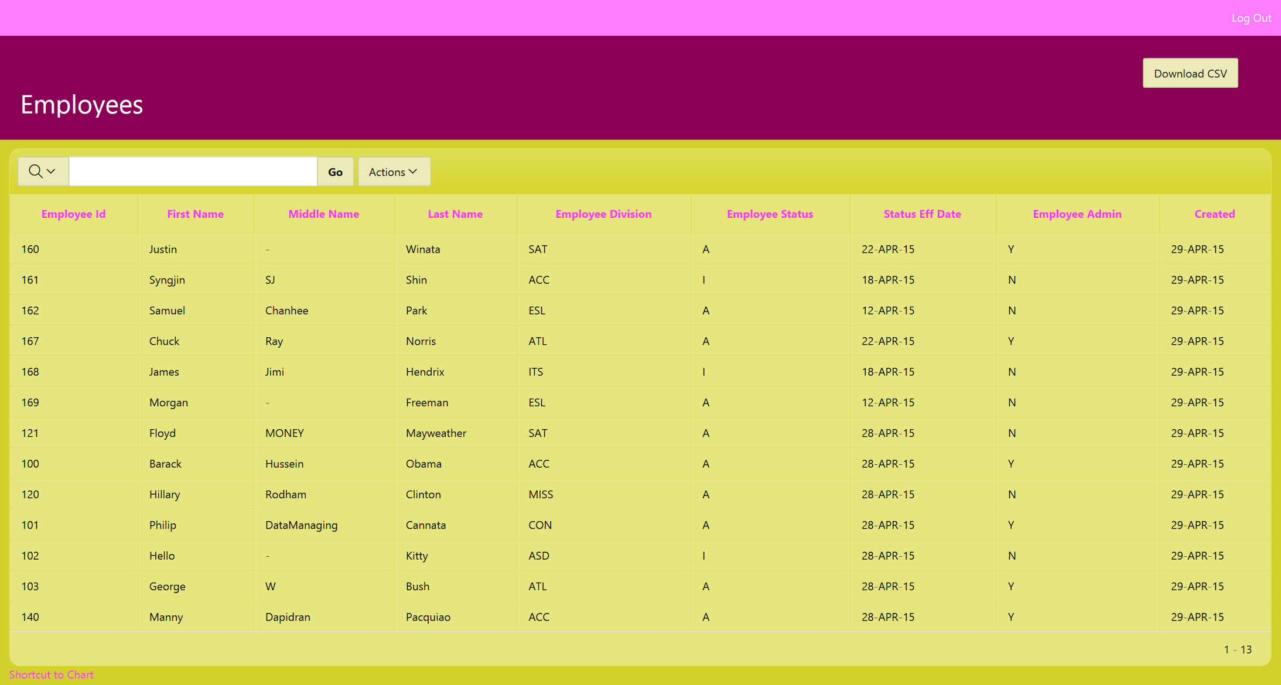
Download

Slide 12
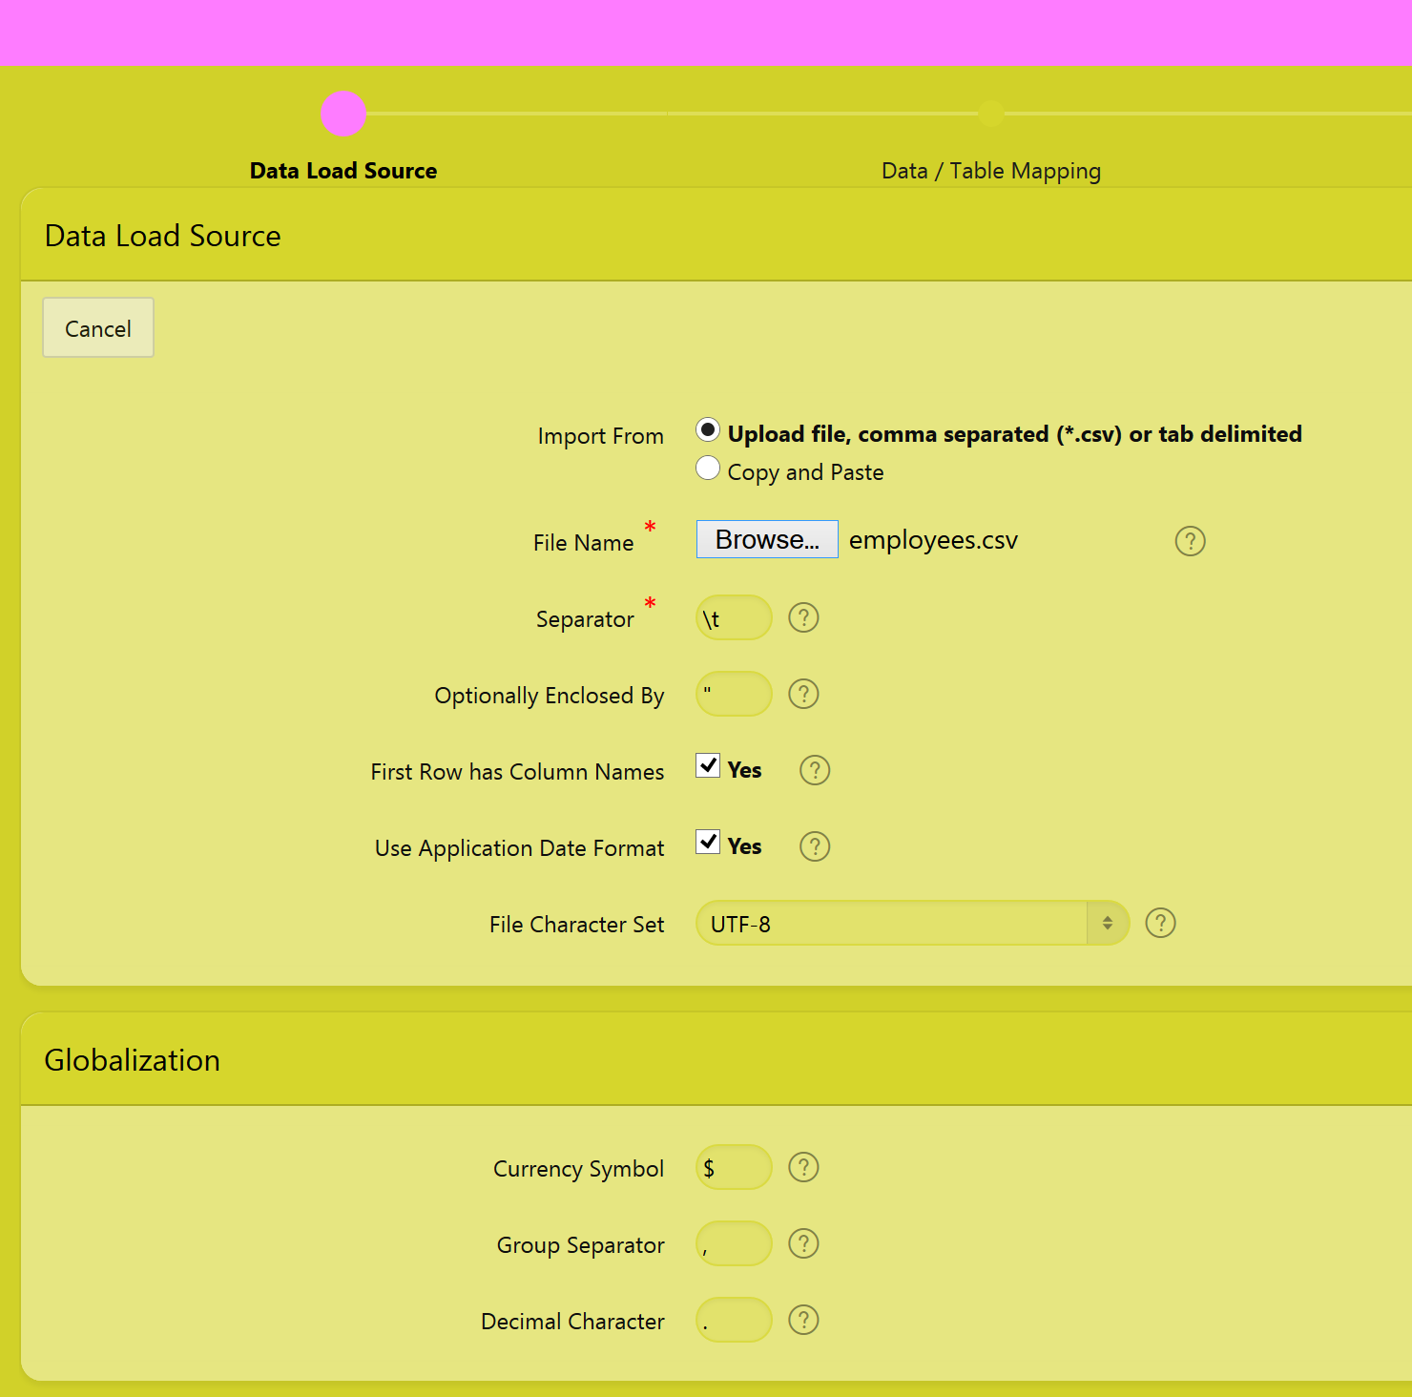
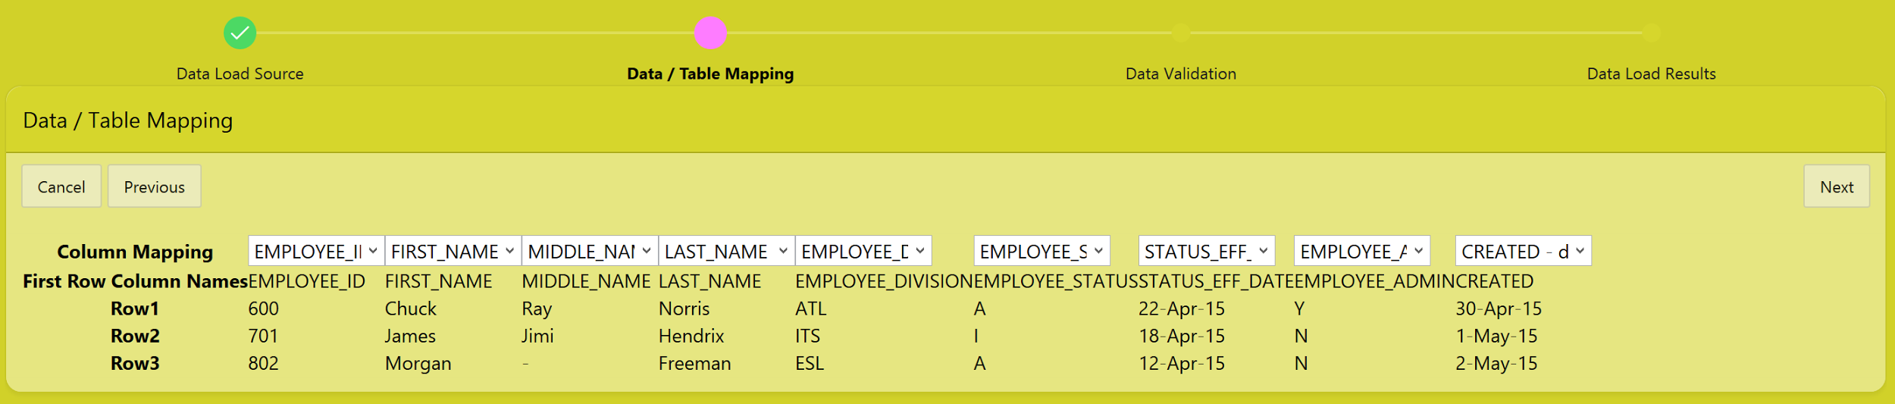
Data Loading

Slide 13
Shortcut

Slide 14
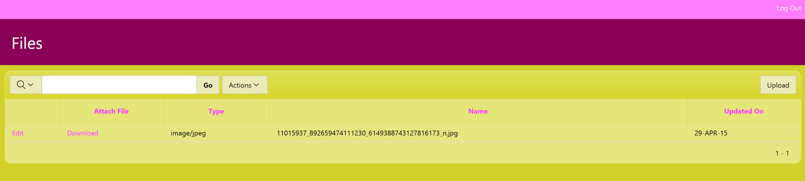
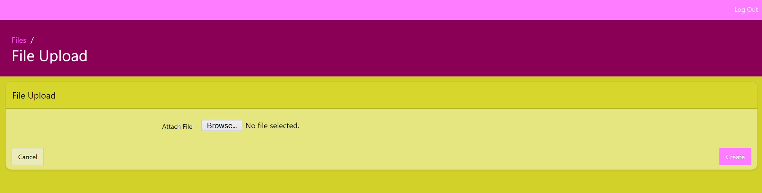
File Upload

Slide 15
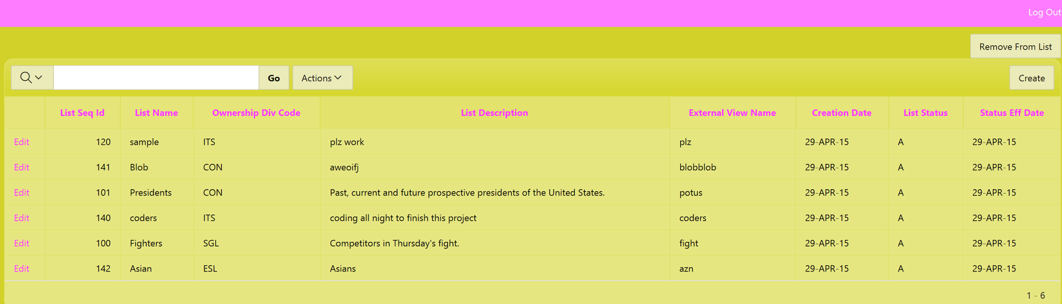
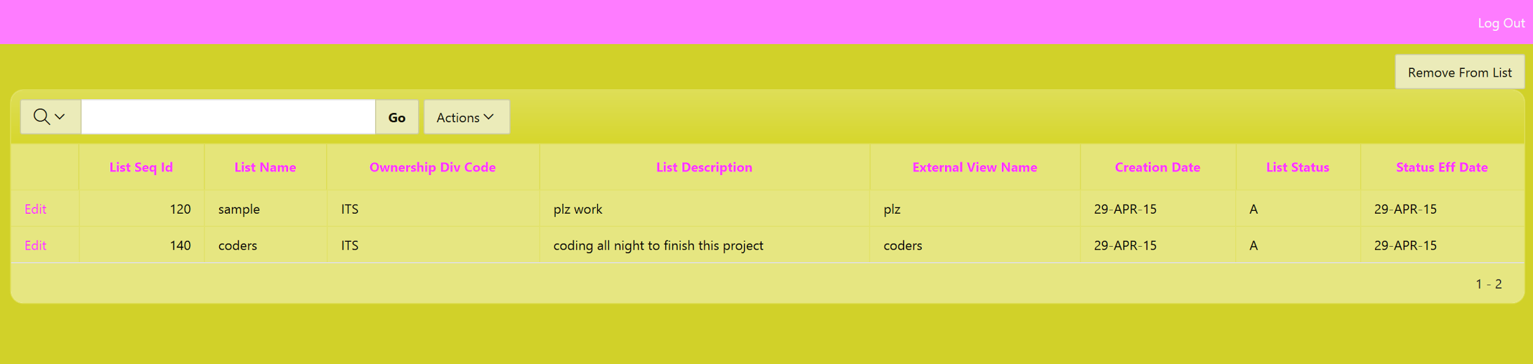
Admin vs Standard
Admin user Standard User

